Slide 1
EOL-Middleware Upgrade
- CorpMQ (server switchover)
Oct 2016
IT Scheduled Maintenance

Slide 2
Scope (EOL middleware infra)
EOL - Middleware Upgrade Phase 3: Upgrade CorpMQ in end of life middleware components - tentative go-live date : Sep 2017
New platform is running on a dedicated ESX 6.0 farm and 10G network which is isolated from other ESX farm
Implement Active-Standby solution for all the above middleware components
Decommission of existing platform

Slide 3
High-level Infra Design
Servers are running on a dedicate VMWare ESX 6.0 farm on 10G network
WAS & WSRR, – HA by WebSphere Cluster build-in features
IIB & WMQ – HA by Veritas Cluster Server (VCS) to replace HACMP
Adopted SRM for the standby Environment Setup
Use Extended VLAN across IMC1 and IMC2 for the MQ Service IP Failover

Slide 4
Middleware Version Upgrade
The changes are summarized into the following table, which are synchronized with the approved IDD
Component | Network Migration | Server Re-platforming | Middleware Upgrade | HACMP Migration | Resiliency Design
WAS | 1G → 10G | RHEL 6.1 → RHEL 6.6 | 7.0 → 8.5 (7.0 EOS 2018) | -- | SRM
WMQ | 1G → 10G Extended VLAN (MQ Service IP) | AIX 6.1 → RHEL 6.6 | 7.0 → 8.0 (7.0 EOS Sep/2015) | Veritas Cluster Server (VCS) | SRM
IIB (WMB) | 1G → 10G Extended VLAN (MQ Service IP) | AIX 6.1 → RHEL 6.6 | 7.0 → 9.0 (7.0 EOS Sep/2015) | Veritas Cluster Server (VCS) | SRM
WSRR | 1G → 10G | AIX 5.3 → RHEL 6.6 | 6.2 → 8.5 (already EOS) | -- | SRM
Log Server | 1G → 10G | RHEL 6.1 → RHEL 6.6 | -- | -- | SRM
CorpMQ | 1G → 10G Extended VLAN (MQ Service IP) | AIX 5.3 → RHEL 6.6 | 6.0 → 8.0 (6.0 EOS Sep/2012) | Veritas Cluster Server (VCS) | SRM

Slide 5
Current State Infra Architecture

Slide 6
Target State Infra Architecture

Slide 7
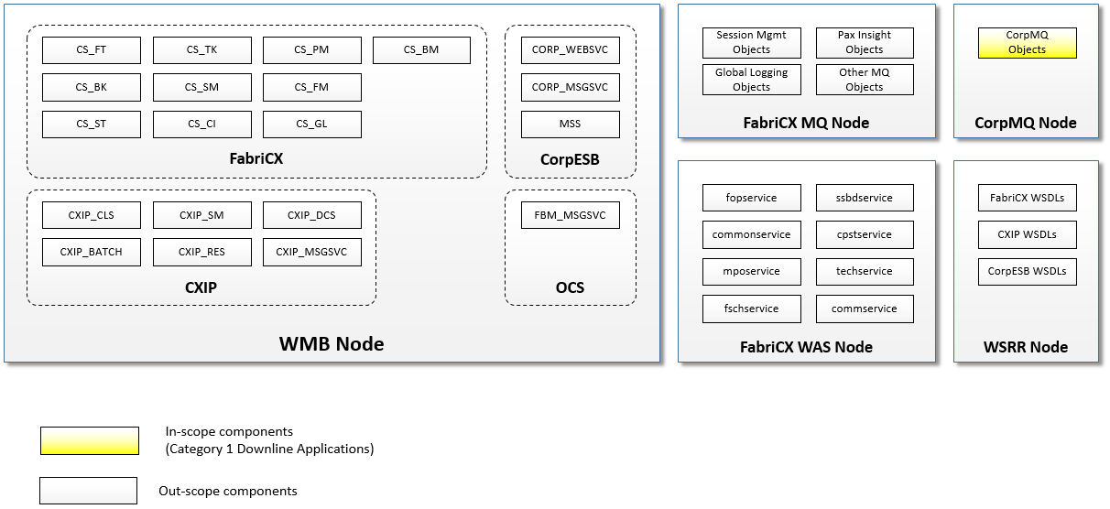
In-scope Components (CorpMQ)

Slide 8
CorpMQ Server Switchover Approach
In order to minimize the risk of current CorpMQ servers (IBM P6 machines with HACMP), we can have a short-term solution to mitigate this risk first:
a virtualized server switchover to IBM P7 machines is to be used for all queue managers, channels and queues in big bang cutover
will be done in one single batch for all downline applications involved
hardware platform and OS will be upgraded with the same hostname
stay in the same VLAN and have the same IPs of new P7 machines
software version of IBM Websphere MQ will maintain in the current EOL version 6.0

Slide 9
CorpMQ Migration – CorpMQ and Downline Applications Analysis
Item | Number
Queue Managers in production CorpMQ | 4
CPA Queue Managers connecting to production CorpMQ | 16
External party Queue Managers connecting to production CorpMQ | TBC
Local Queues in production CorpMQ | 396
Remote Queues in production CorpMQ | 236
Channels in production CorpMQ | 236
IBM ASM managed applications using production CorpMQ | 65
Solution Centre managed applications using production CorpMQ | ~45
External party managed applications using production CorpMQ | TBC
External parties having connection with produciton CorpMQ | 13

